Slide 1
DMRG-inspired Algorithms for Compression of Neural Networks
Bachelor Exam Presentation
Aaron Sander
18 September 2020

Slide 2
Personal Motivation
Interest in the direction of quantum science, specifically on the application-side
Significant experience with programming, some experience with machine learning
Began with a vague understanding of tensor networks after visiting the LMU lecture a few semesters ago
Interest in the papers published by Dr. Nicola Pancotti (and colleagues) in the Max Planck Quantum Optics Theory Divsion

Slide 3
Abbreviations
Matrix Product State (MPS)
Matrix Product Operator (MPO)
Singular Value Decomposition (SVD)
Density Matrix Renormalization Group (DMRG)
Fully Connected 2-Layer Network (FC2)

Slide 4
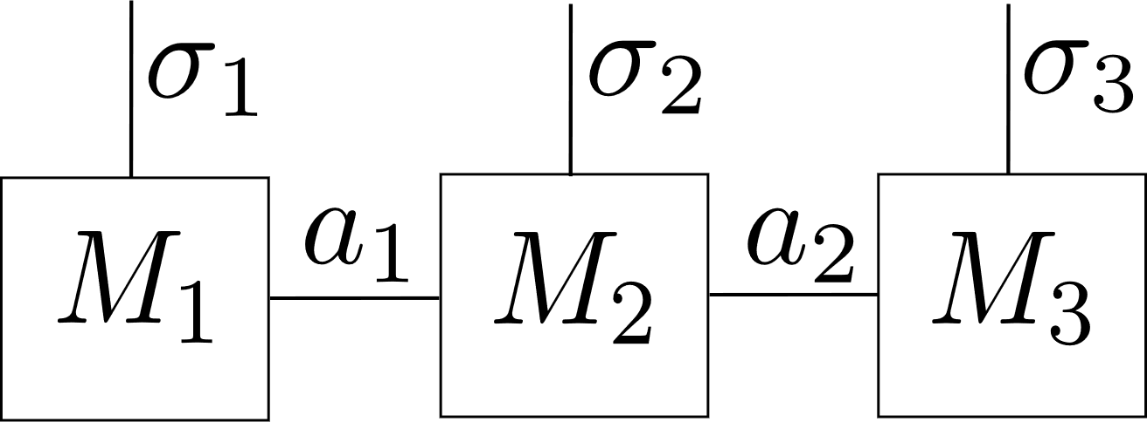
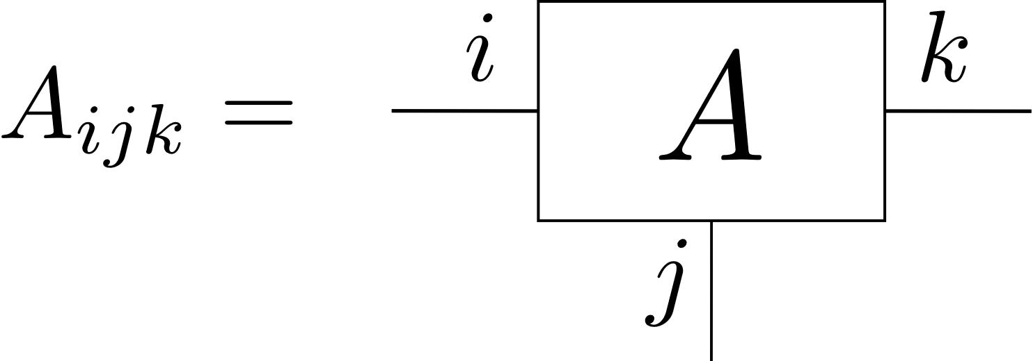
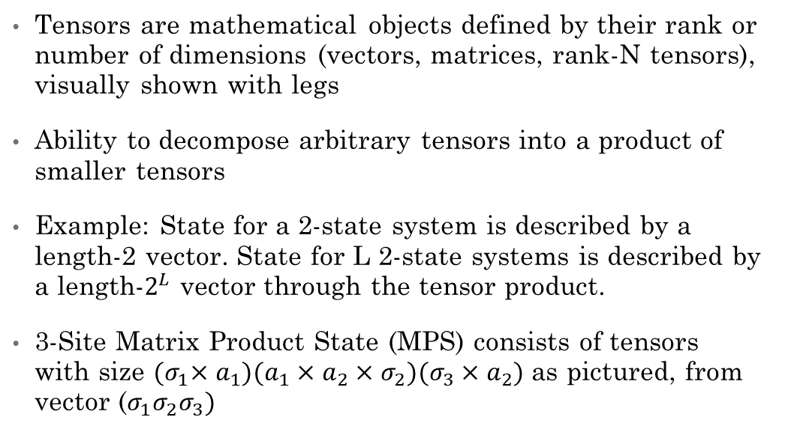
What are tensor networks?
Tensors are mathematical objects defined by their rank or number of dimensions (vectors, matrices, rank-N tensors), visually shown with legs
Ability to decompose arbitrary tensors into a product of smaller tensors
Example: State for a 2-state system is described by a length-2 vector. State for L 2-state systems is described by a length-$2^{L}$ vector through the tensor product.
3-Site Matrix Product State (MPS) consists of tensors with size ${(σ}_{1}×a_{1})(a_{1}×a_{2}×σ_{2})(σ_{3}×a_{2})$ as pictured, from vector ($σ_{1}σ_{2}σ_{3})$

Slide 5
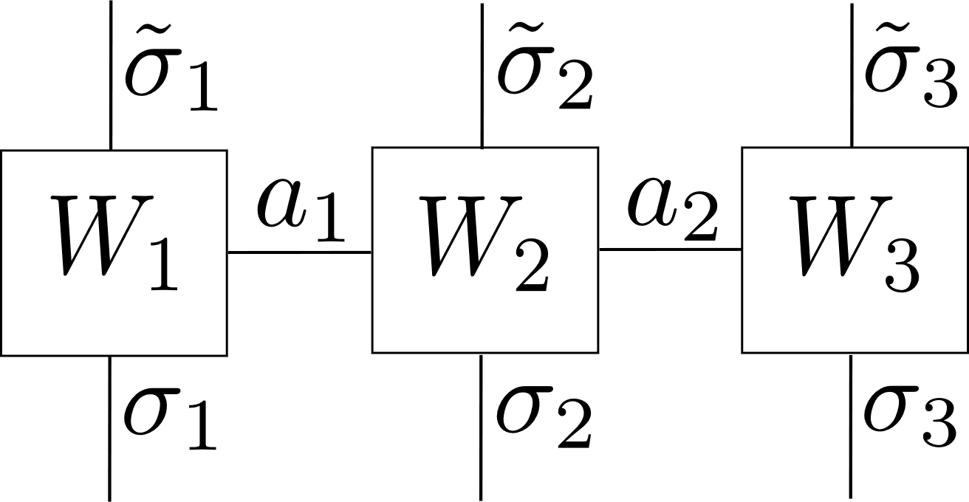
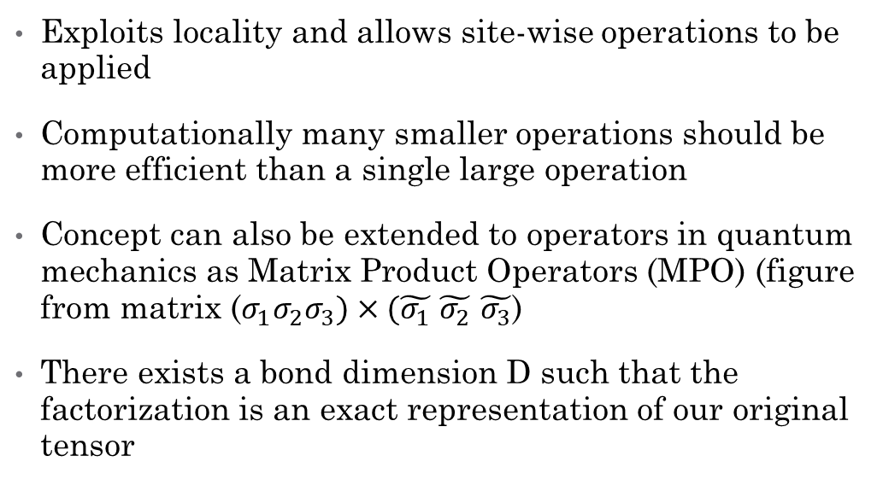
What are tensor networks?
Exploits locality and allows site-wise operations to be applied
Computationally many smaller operations should be more efficient than a single large operation
Concept can also be extended to operators in quantum mechanics as Matrix Product Operators (MPO) (figure from matrix ($σ_{1}σ_{2}σ_{3})×(\tilde{σ_{1}}$ $\tilde{σ_{2}}$ $\tilde{σ_{3}}$)
There exists a bond dimension D such that the factorization is an exact representation of our original tensor

Slide 6
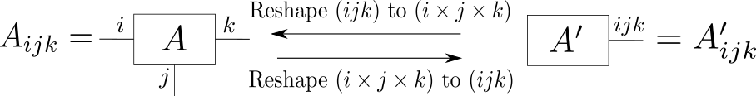
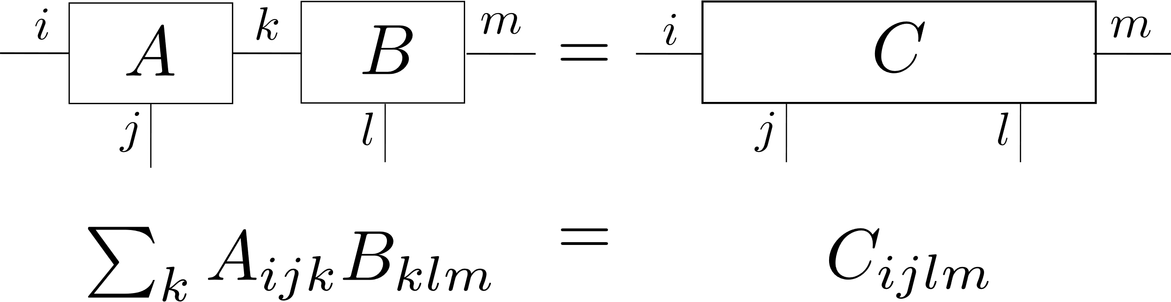
Important Properties

Slide 7
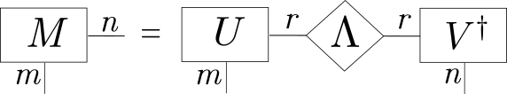
Decomposing a tensor into an MPS
Algorithm begins with a vector, which any tensor can be reshaped into
This is then reshaped into a matrix according to the desired physical dimension such that the “Compact SVD” can be applied which removes non-zero singular values
We exploit the SVD such that eigenvector matrix is reshaped into our site tensor
This is repeated until we fully decompose our tensor completely into L sites

Slide 8
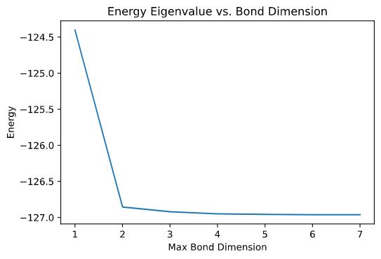
What is DMRG?
Algorithm for solving for the ground state MPS as well as the ground state eigenvalue for some operator
Typically applied to Hamiltonians to find the ground state energy
General Idea: Sweeps back and forth optimizing site-wise until we reach a solution (i.e. difference in energy between scans is under some threshold)
Figure shows Ising model Hamiltonian for J=1, g=1 and 100 particles

Slide 9
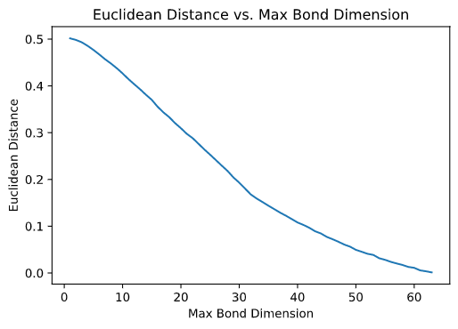
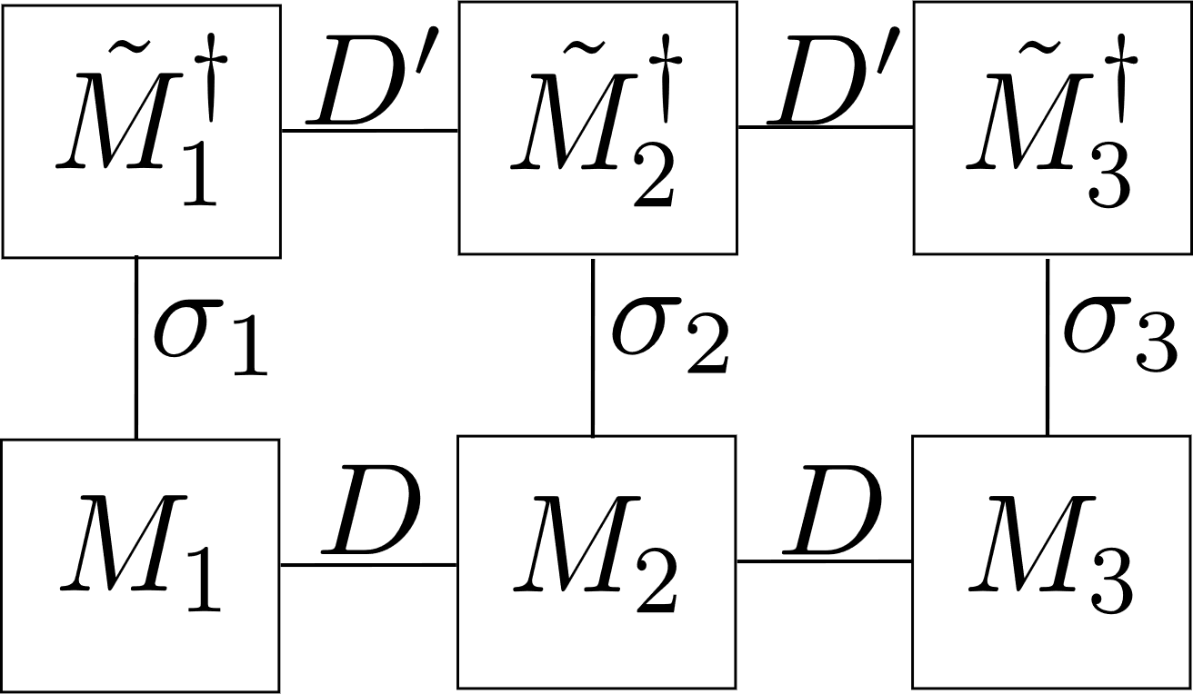
DMRG Compression: Theory
As mentioned, states are represented exactly for a given bond dimension D
We can create an MPS with bond dimension D’ < D and apply a DMRG-like algorithm
This minimizes the Euclidean distance between our original MPS and compressed MPS by sweeping back and forth
Overall: We can represent a tensor exactly as an MPS and compress it even further by reducing the bond dimension

Slide 10
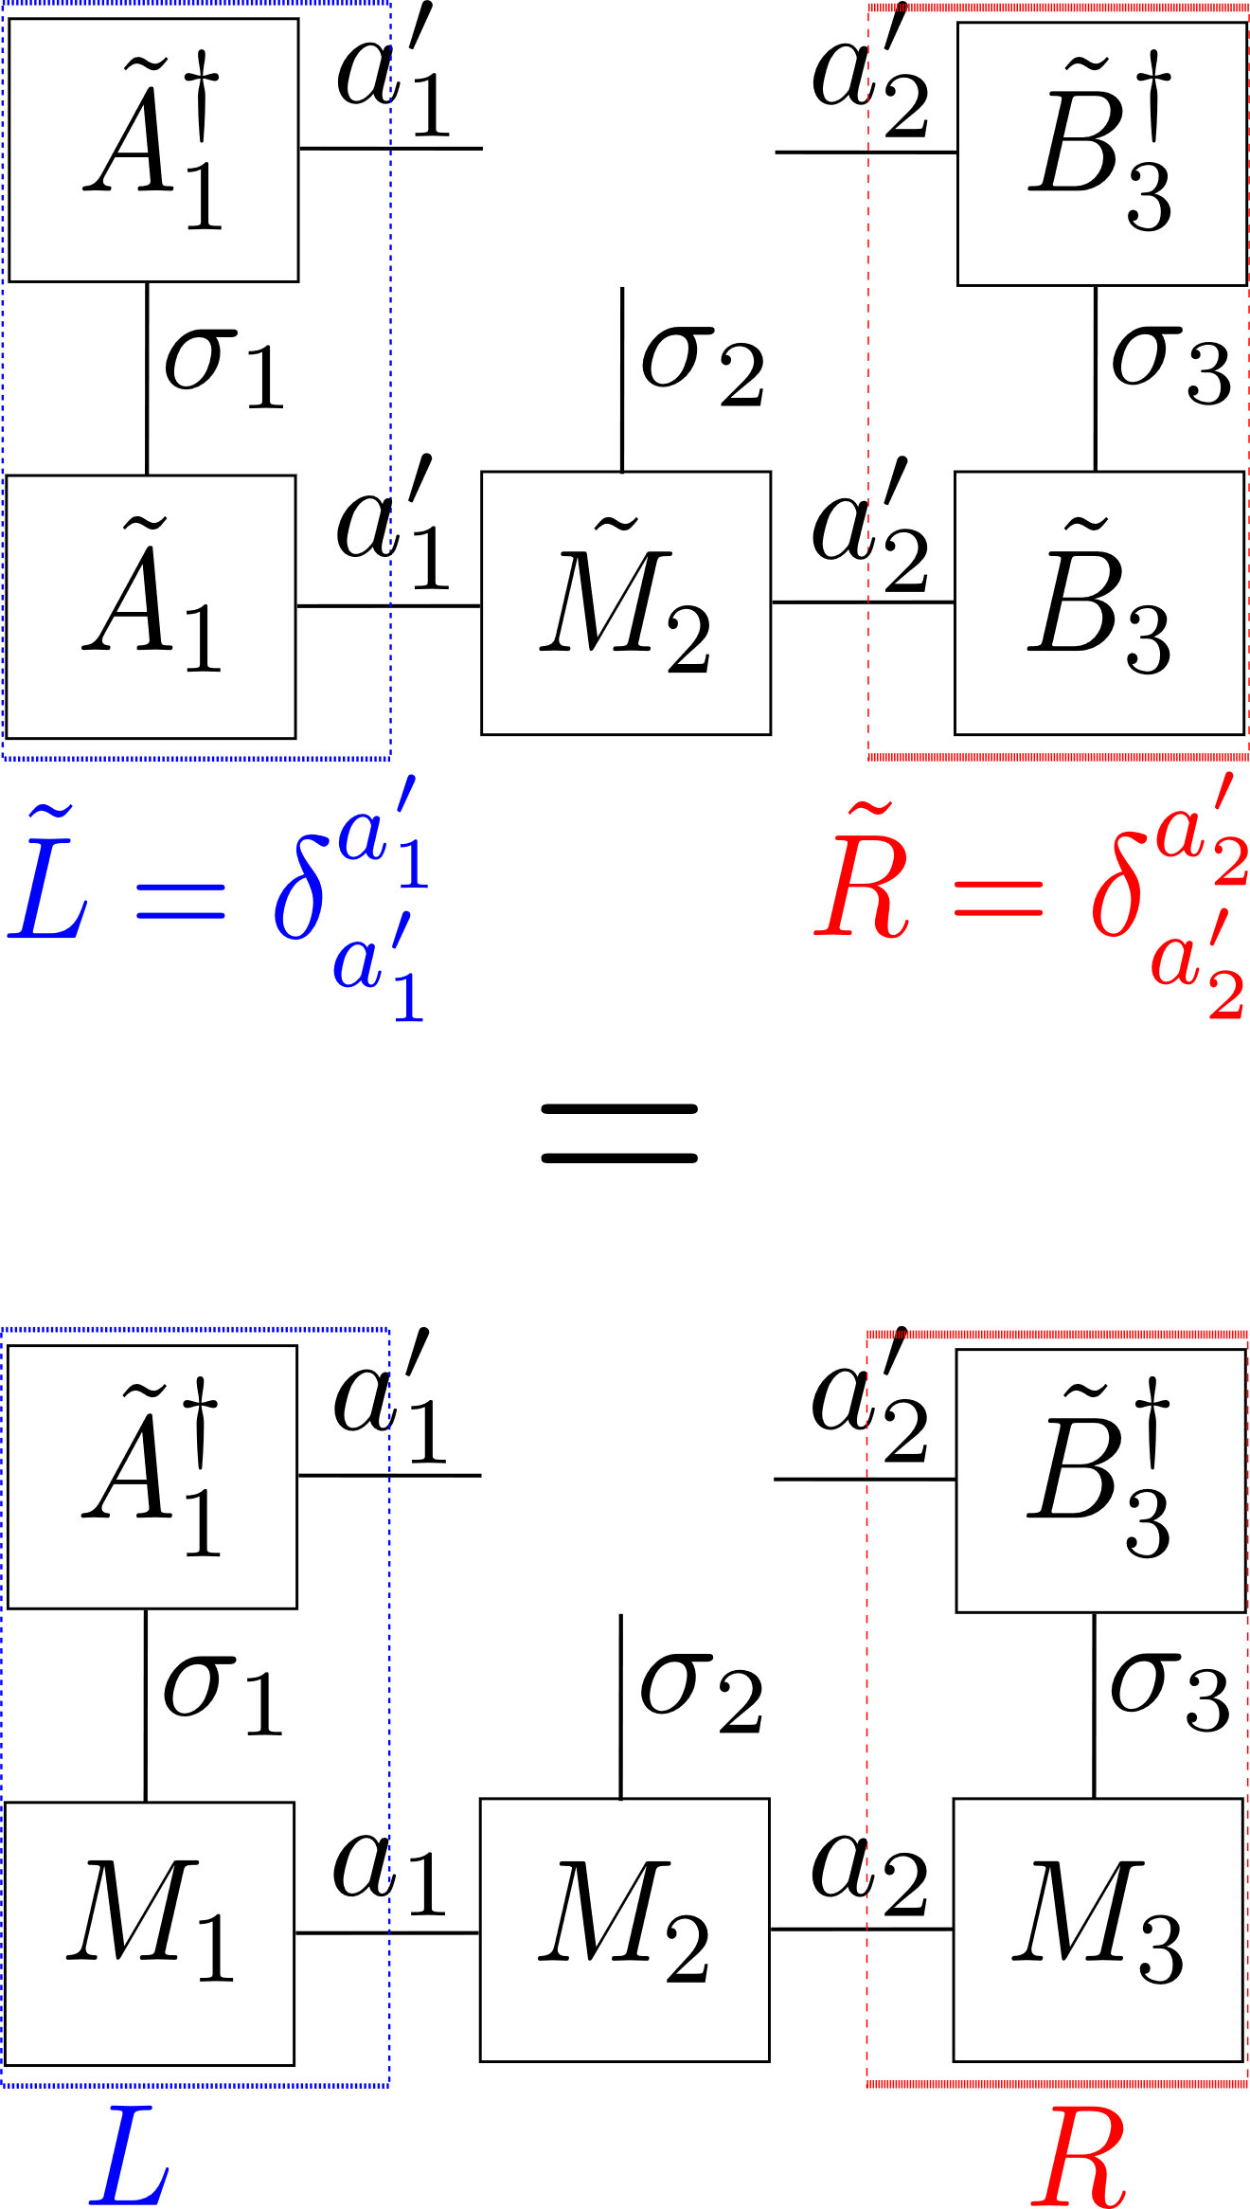
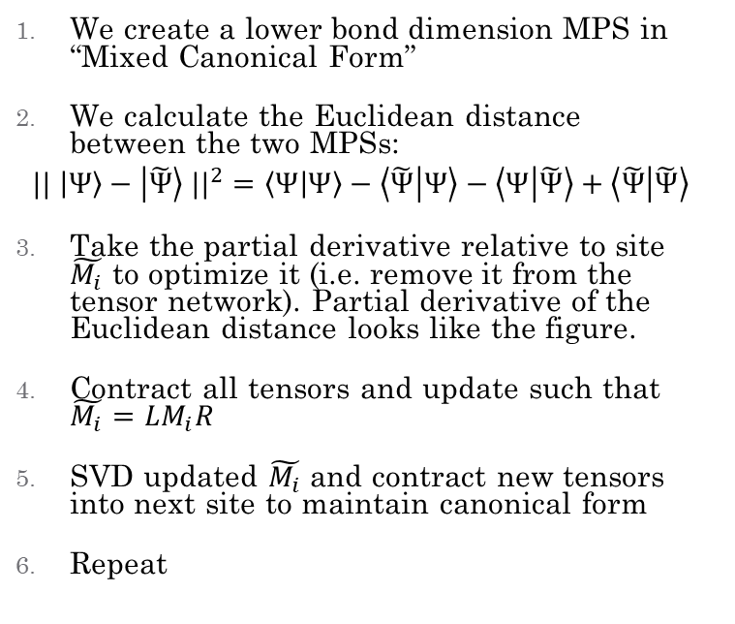
DMRG Compression: Algorithm
We create a lower bond dimension MPS in “Mixed Canonical Form”
We calculate the Euclidean distance between the two MPSs:
$$|| \left|Ψ\right\rangle −\left|\tilde{Ψ}\right\rangle ||^{2}=\left\langle Ψ | Ψ\right\rangle −\left\langle \tilde{Ψ} | Ψ\right\rangle −\left\langle Ψ | \tilde{Ψ}\right\rangle +\left\langle \tilde{Ψ} | \tilde{Ψ}\right\rangle$$
Take the partial derivative relative to site $\tilde{M_{i}}$ to optimize it (i.e. remove it from the tensor network). Partial derivative of the Euclidean distance looks like the figure.
Contract all tensors and update such that $\tilde{M_{i}}=LM_{i}R$
SVD updated $\tilde{M_{i}}$ and contract new tensors into next site to maintain canonical form
Repeat

Slide 11
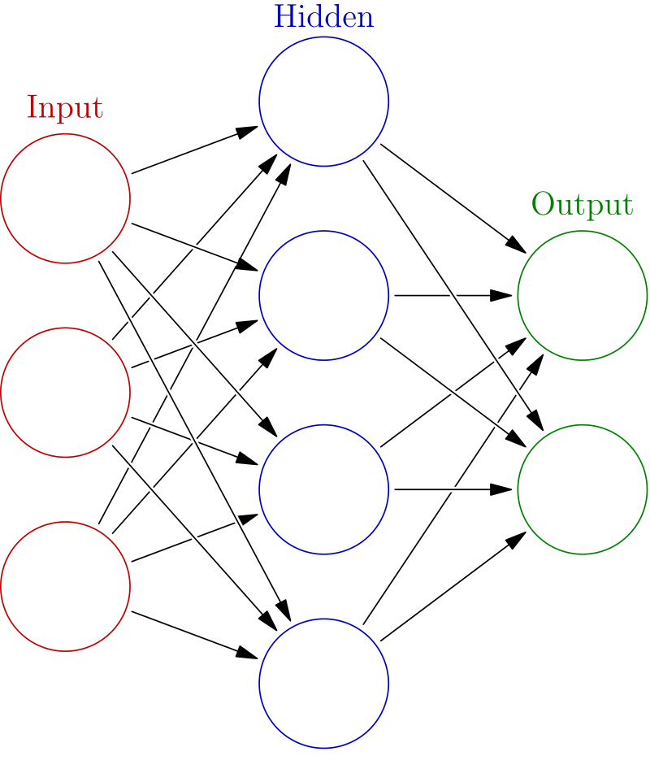
Neural Networks
Consist of layers represented by weights tensors where each element defines the strength of a connection
Each layer applies an activation function, constricting the values allowed through
Models are trained by systematically adjusting weights according to an input and an output (Supervised Learning)
Weights can be counted to give a total number of parameters needed
https://commons.wikimedia.org/wiki/File:Colored_neural_network.svg

Slide 12
Fully-Connected 2 Layer (FC2)
Very basic network used as a proof-of-concept
Applied to MNIST dataset for handwriting recognition
Construction:
Input: (28x28) grayscale image flattened to (784 x 1) vector
Layer 0: (784 x 256) matrix with ReLU activation function + (256x1) bias
Layer 1: (256 x 10) matrix with Linear activation function + (10x1) bias
Output: (10 x 1) vector corresponding to label of image
https://doi.org/10.3390/app9153169

Slide 13
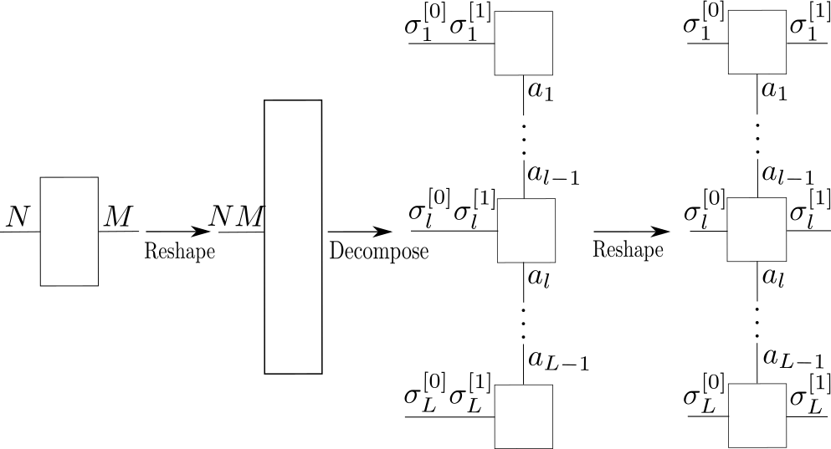
FC2 as an MPS/MPO
We train a model up to some arbitrary accuracy
Layer 0 contains 200704 parameters (without bias)
Layer 1 contains 2560 parameters (without bias)
We can reduce this number by representing the tensor as an MPS/MPO

Slide 14
FC2 as an MPS/MPO
How: Prime factorize each dimension of the tensor, then rearrange them into a list of physical dimensions
784 has factors {2, 2, 2, 2, 7, 7} → (2, 2, 7, 7, 2, 2)
256 has factors {2, 2, 2, 2, 2, 2, 2, 2} →(2, 2, 4, 4, 2, 2,)
Either combine factors or pad with 1s until these are equal length to get our number of sites

Slide 15
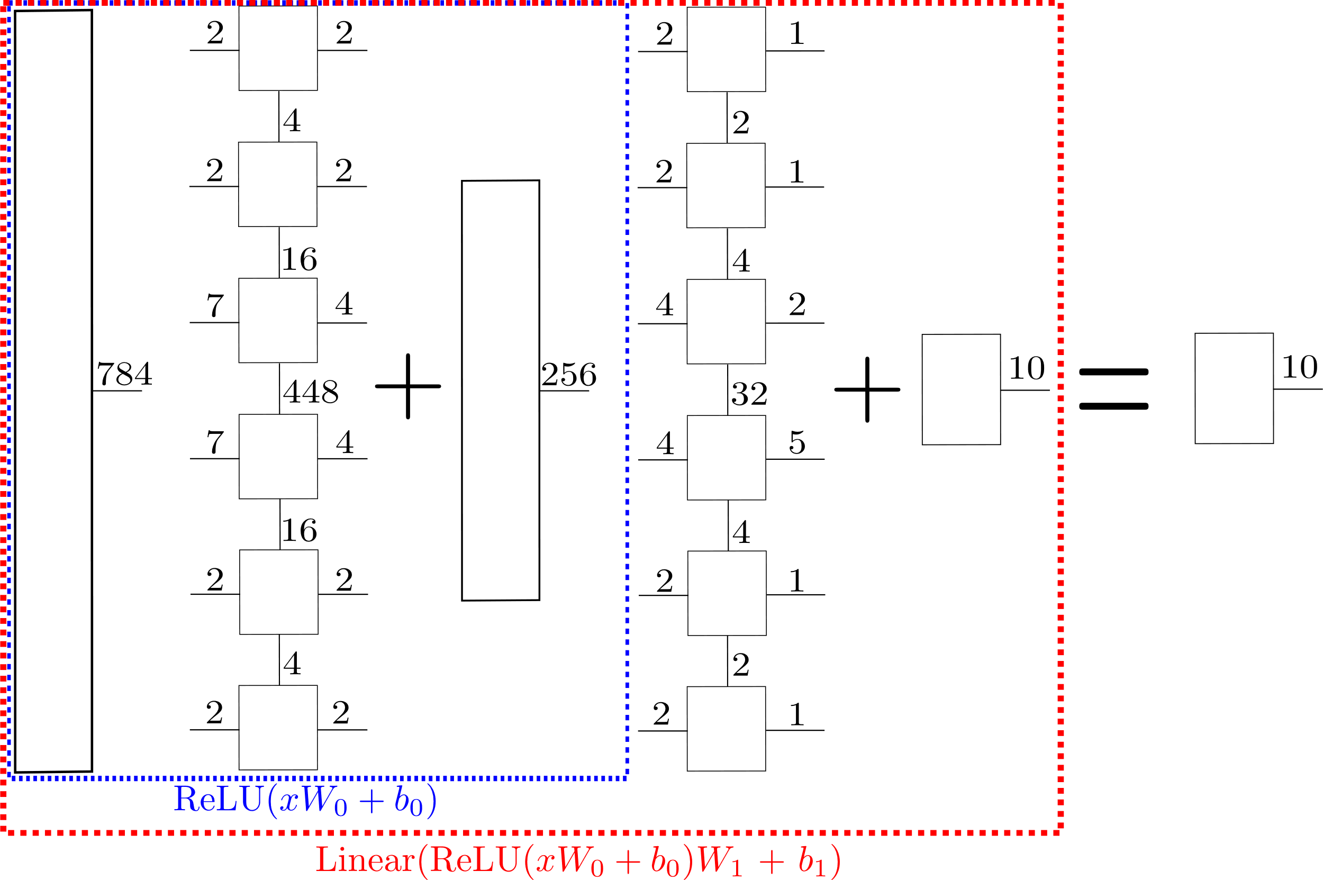
Decomposed FC2

Slide 16
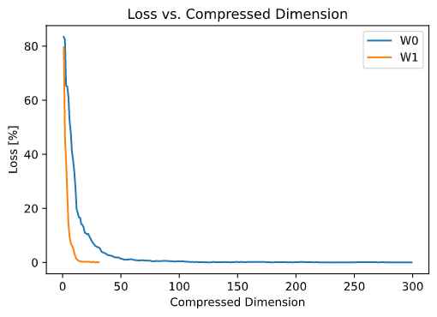
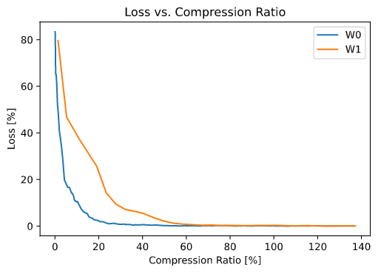
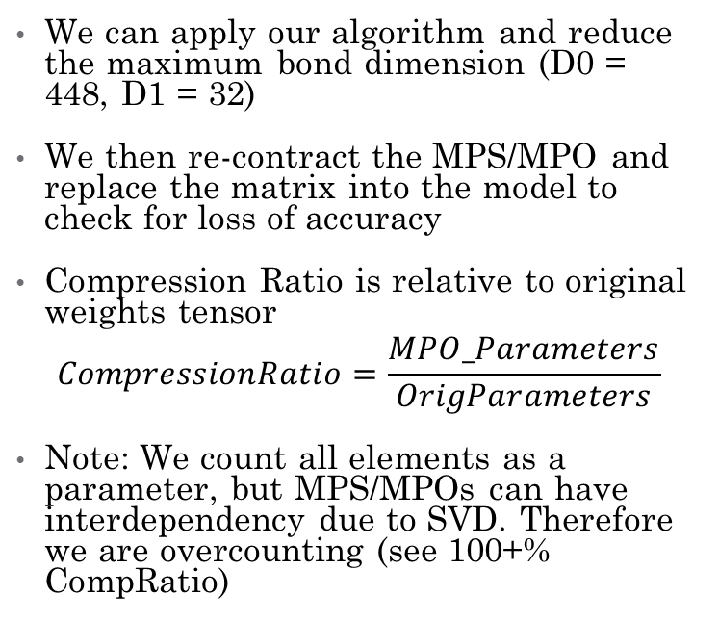
Compressing Each Layer
We can apply our algorithm and reduce the maximum bond dimension (D0 = 448, D1 = 32)
We then re-contract the MPS/MPO and replace the matrix into the model to check for loss of accuracy
Compression Ratio is relative to original weights tensor
$$CompressionRatio=\frac{MPO_Parameters}{OrigParameters}$$
Note: We count all elements as a parameter, but MPS/MPOs can have interdependency due to SVD. Therefore we are overcounting (see 100+% CompRatio)

Slide 17
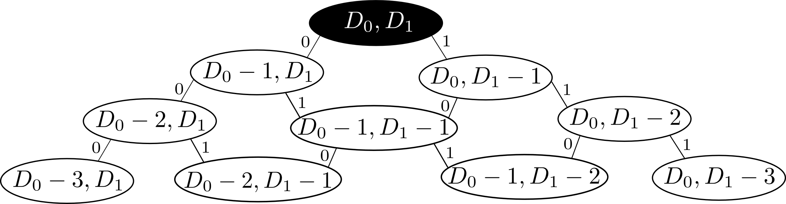
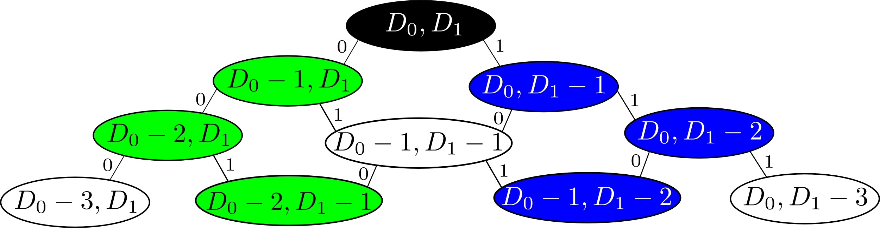
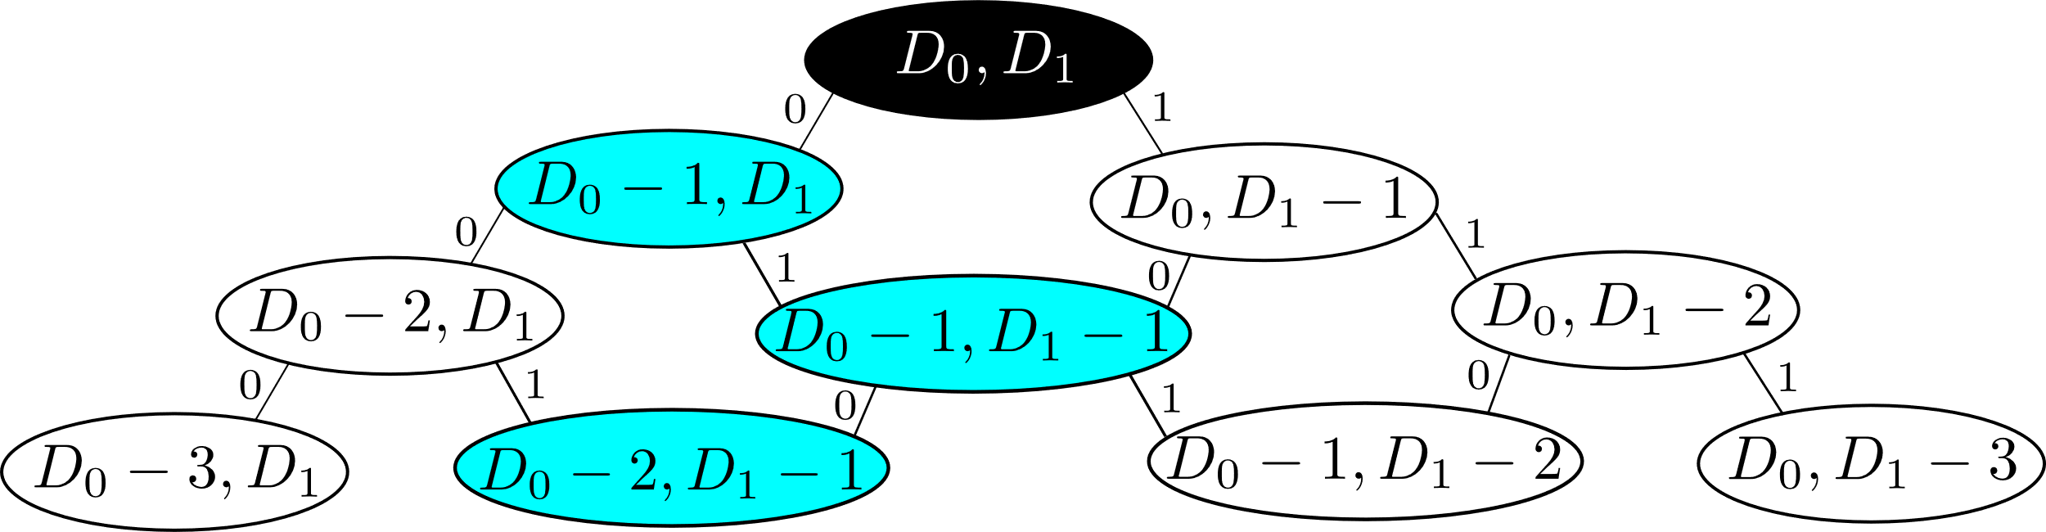
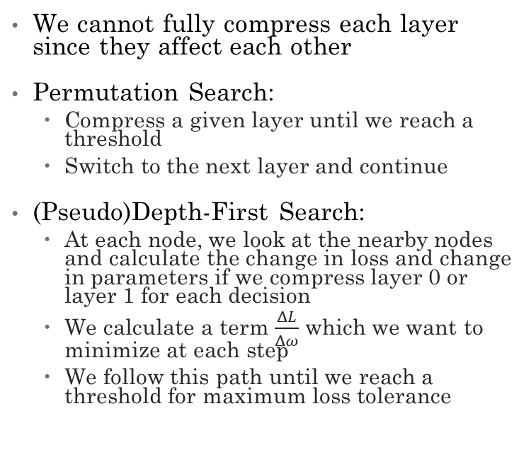
Optimizing the Bond Dimensions
We cannot fully compress each layer since they affect each other
Permutation Search:
Compress a given layer until we reach a threshold
Switch to the next layer and continue
(Pseudo)Depth-First Search:
At each node, we look at the nearby nodes and calculate the change in loss and change in parameters if we compress layer 0 or layer 1 for each decision
We calculate a term $\frac{ΔL}{Δω}$ which we want to minimize at each step
We follow this path until we reach a threshold for maximum loss tolerance

Slide 18
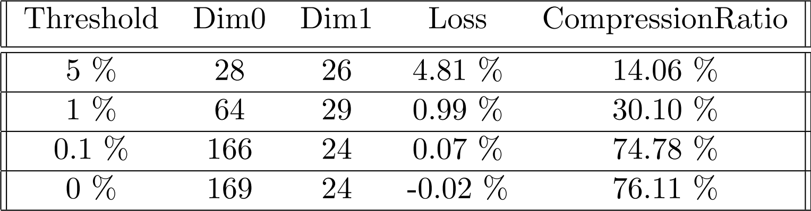
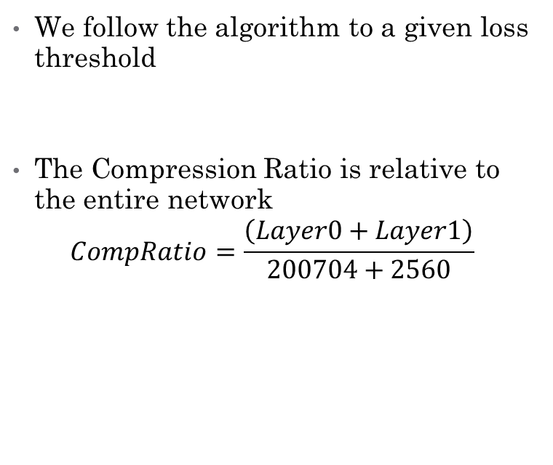
Results: Compressing FC2
We follow the algorithm to a given loss threshold
The Compression Ratio is relative to the entire network
$$CompRatio=\frac{\left(Layer0+Layer1\right)}{200704+2560}$$

Slide 19
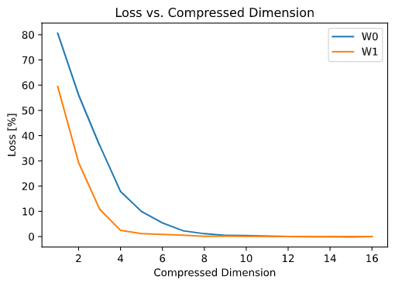
Further Improvement: FC2 MPO Net (Gao 2020)
Trains the network with an MPO structure
Bond dimension is chosen as a hyperparameter
Significant compression while reaching similar accuracies according to their results
Figure was for an initial training of D=16 for both layers. Note that we reach much lower bonds than previously.

Slide 20
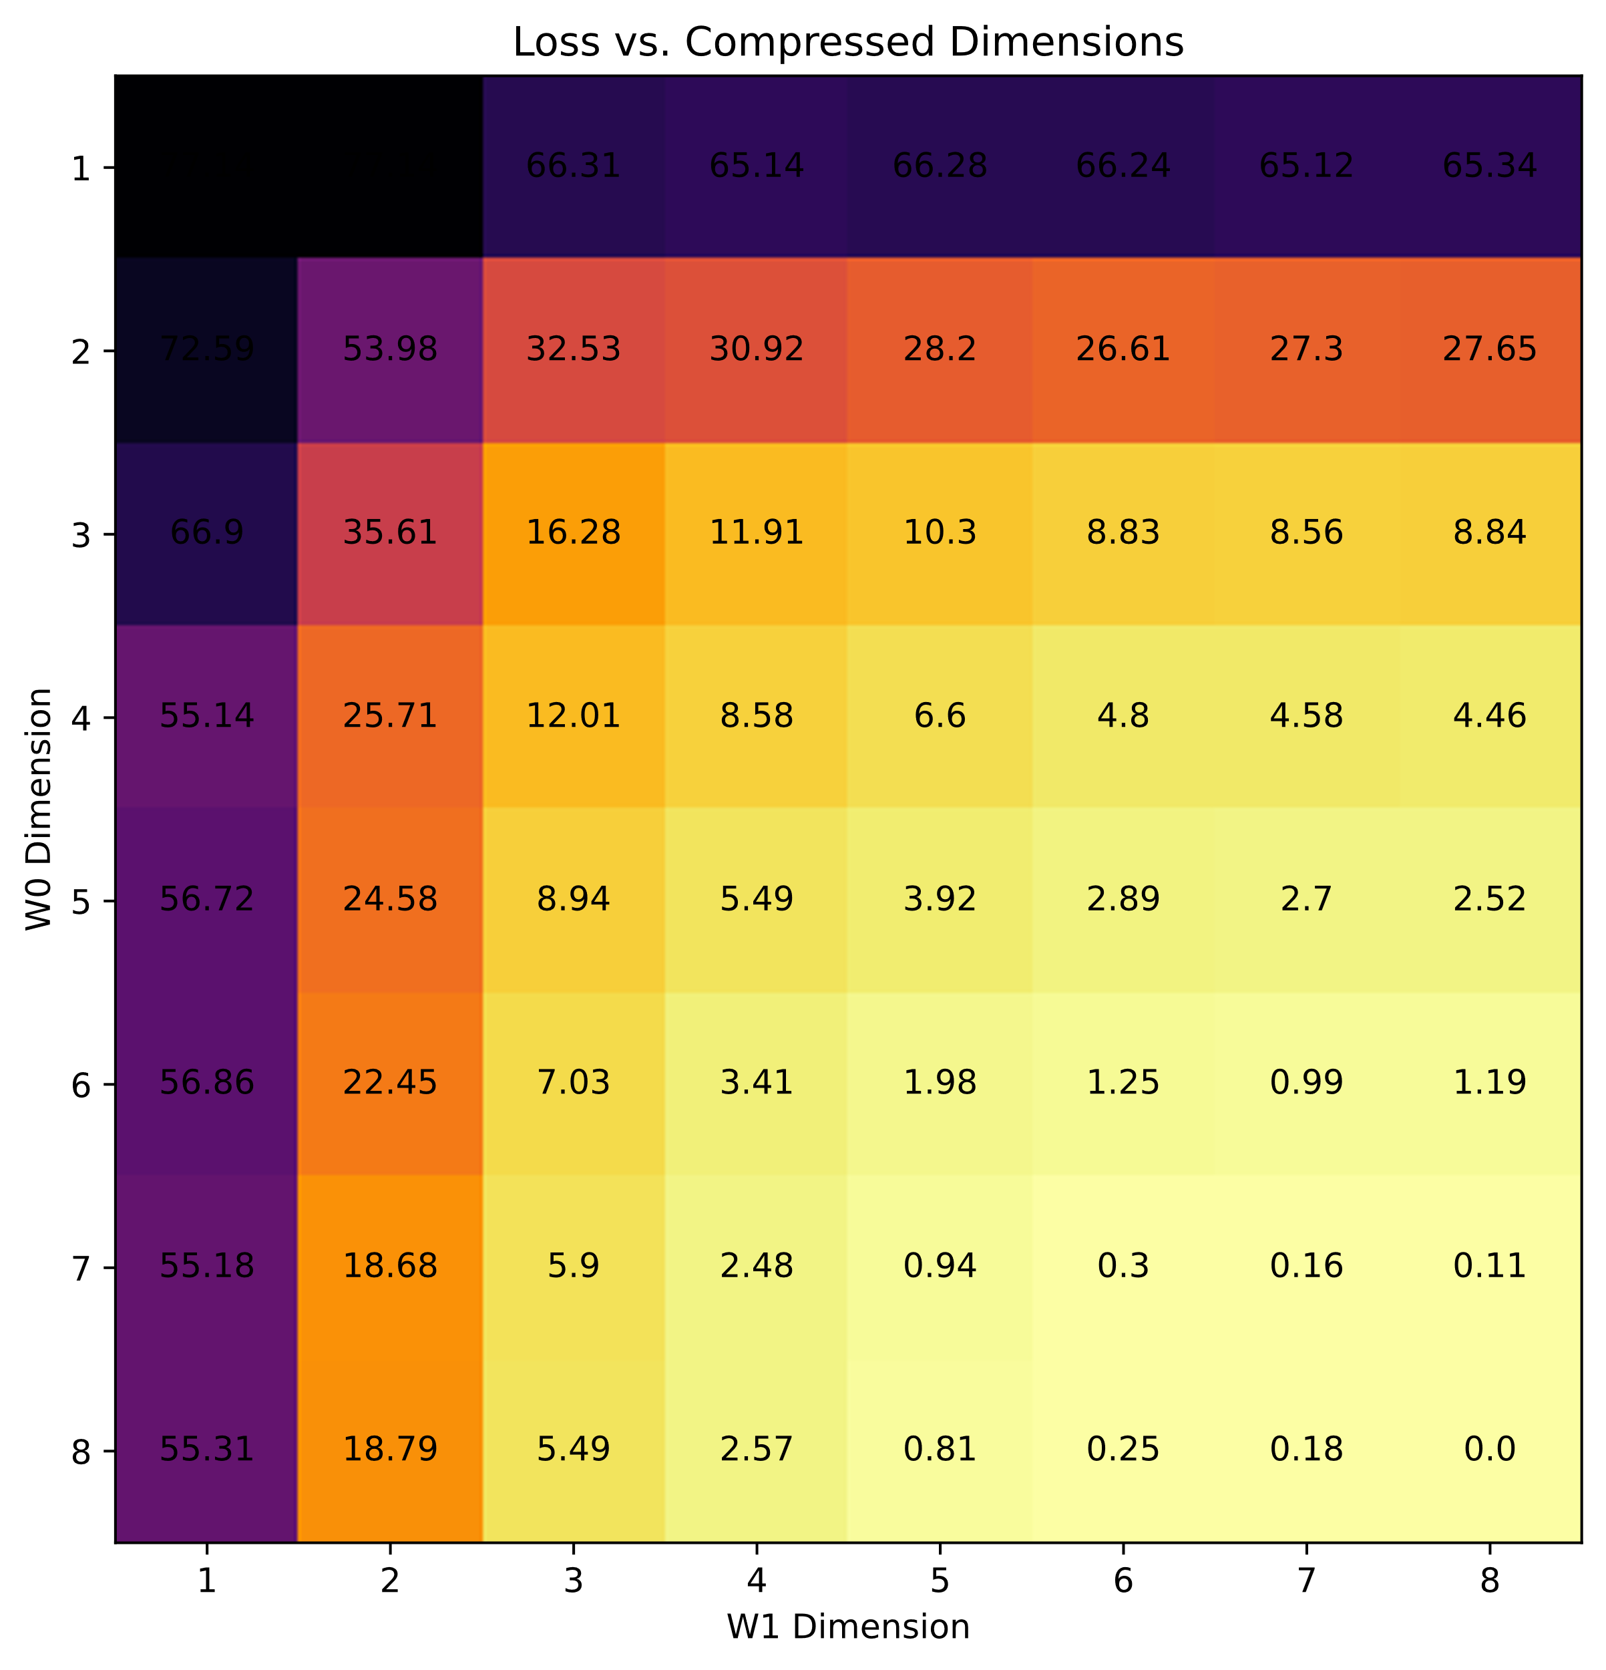
Visualization of Compression Graph
We can build intuition since this is a shallow network and now with few bond dimensions (For deep networks with N layers in N-dimensional space, we cannot calculate all nodes beforehand)
Trained both layers at D = 8
Initial node is bottom right (8,8) from which we follow a graph
We can only see neighboring nodes

Slide 21
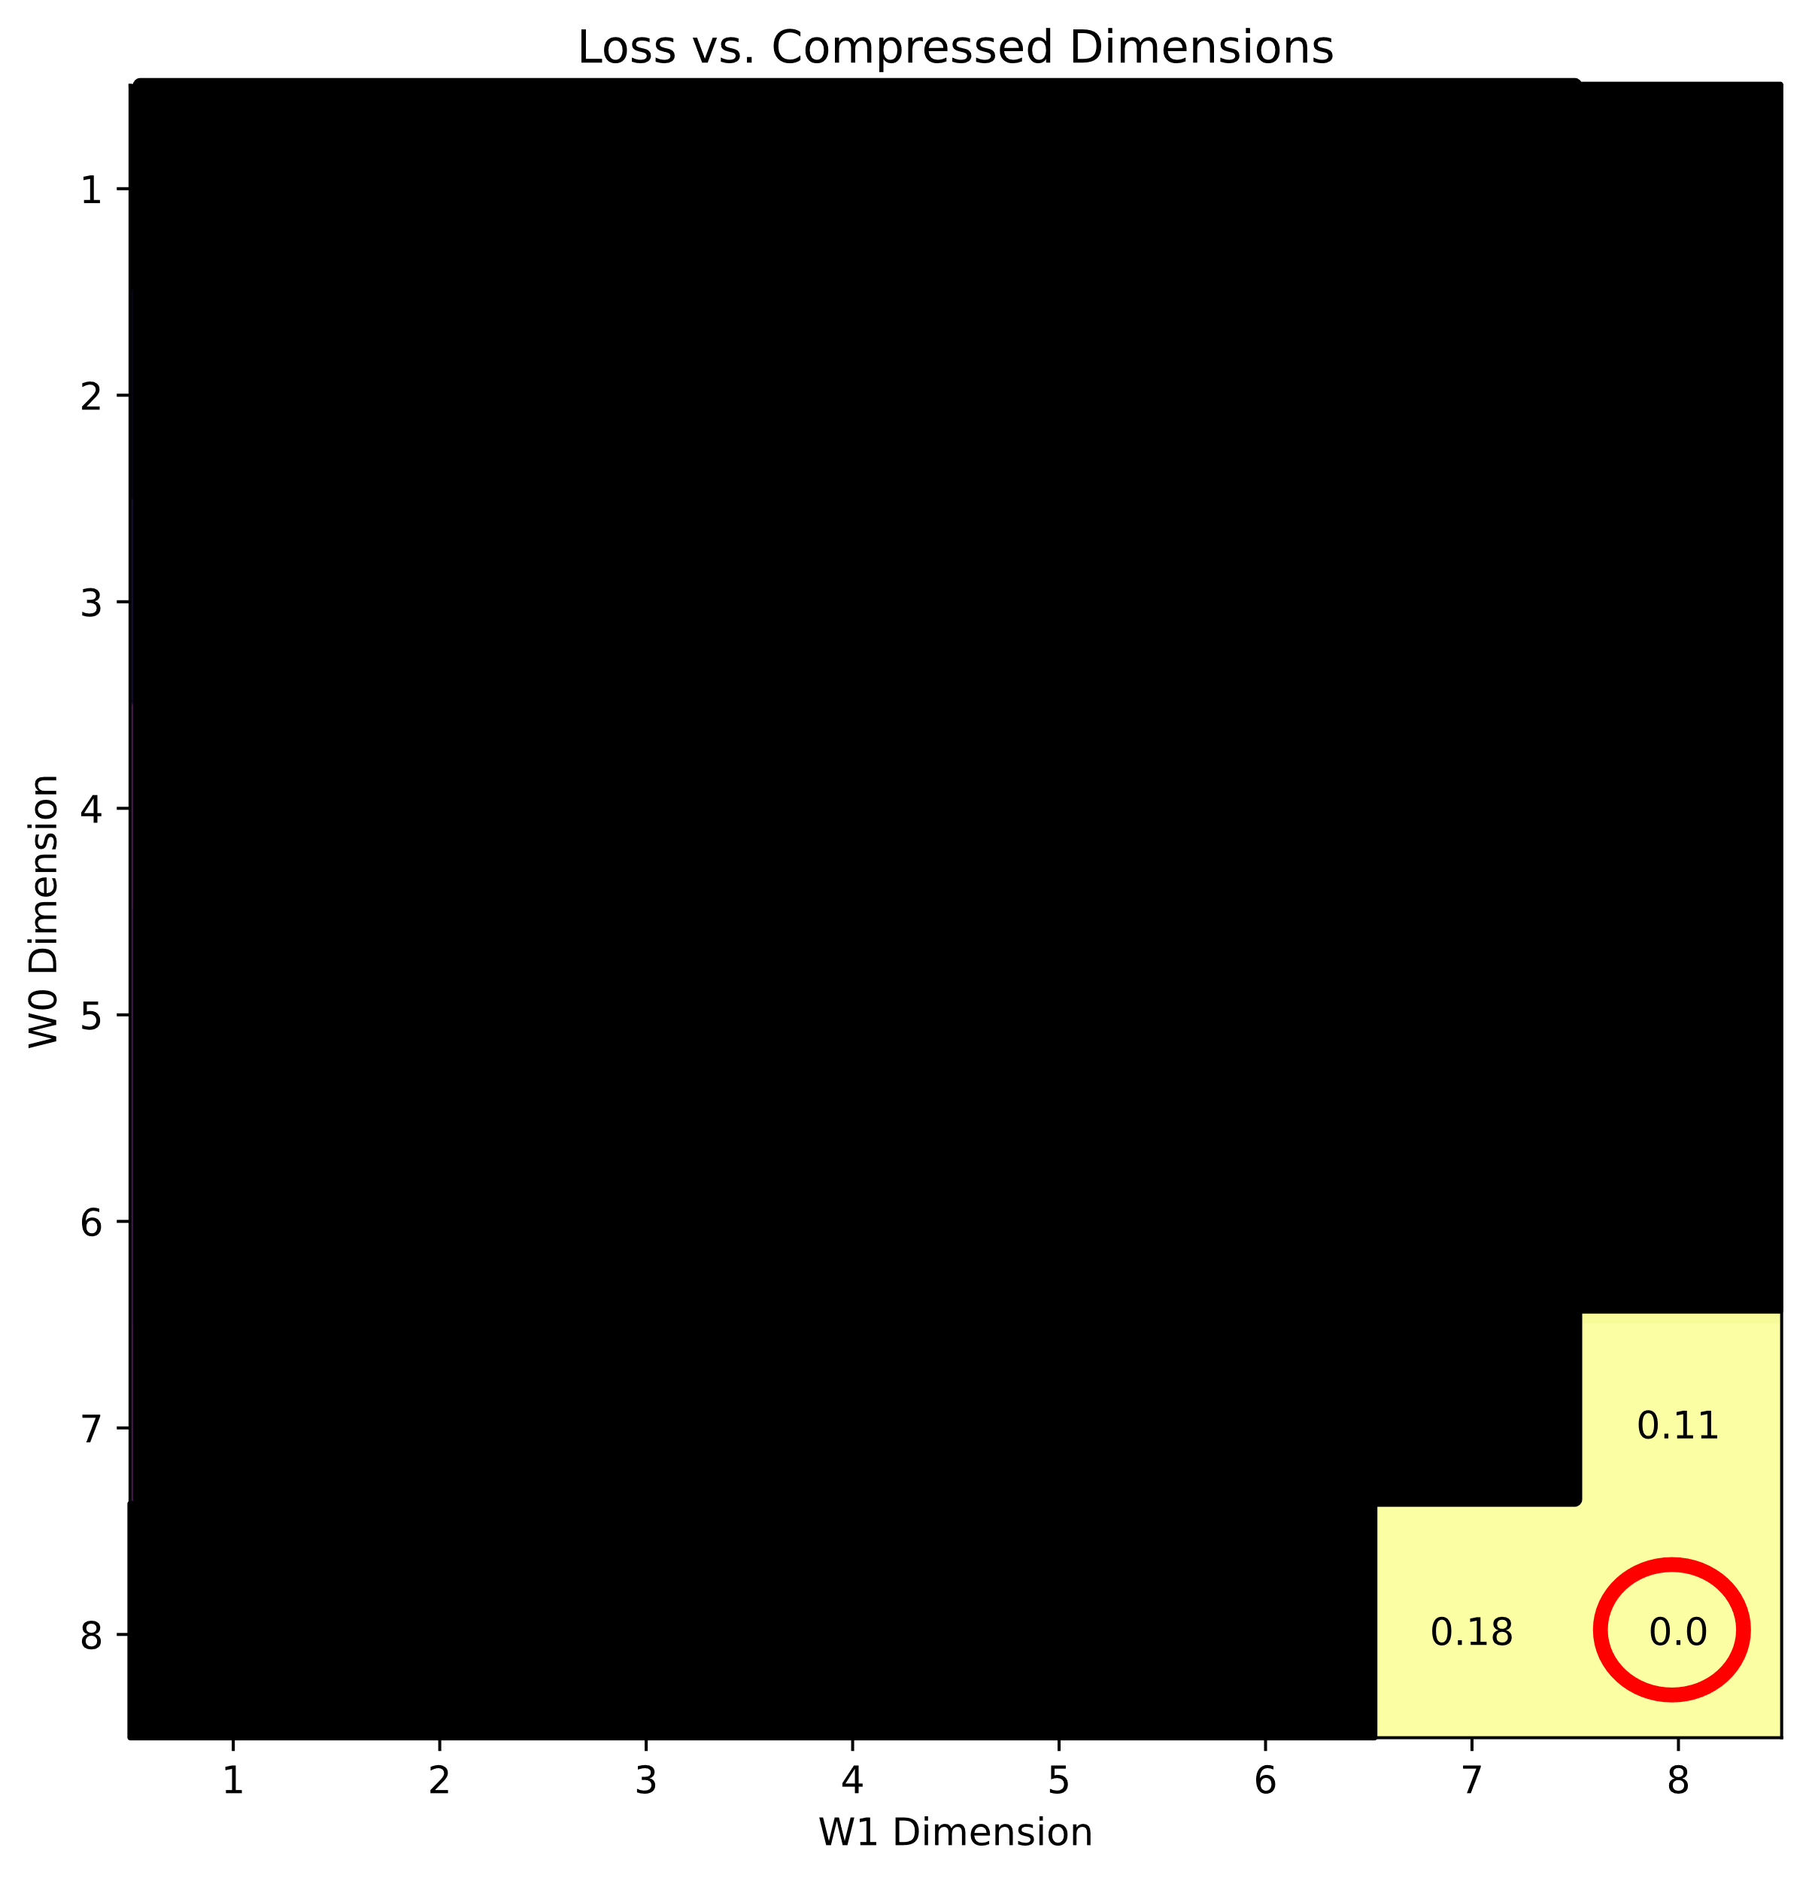
Search Algorithm up to 1 % Threshold

Slide 22
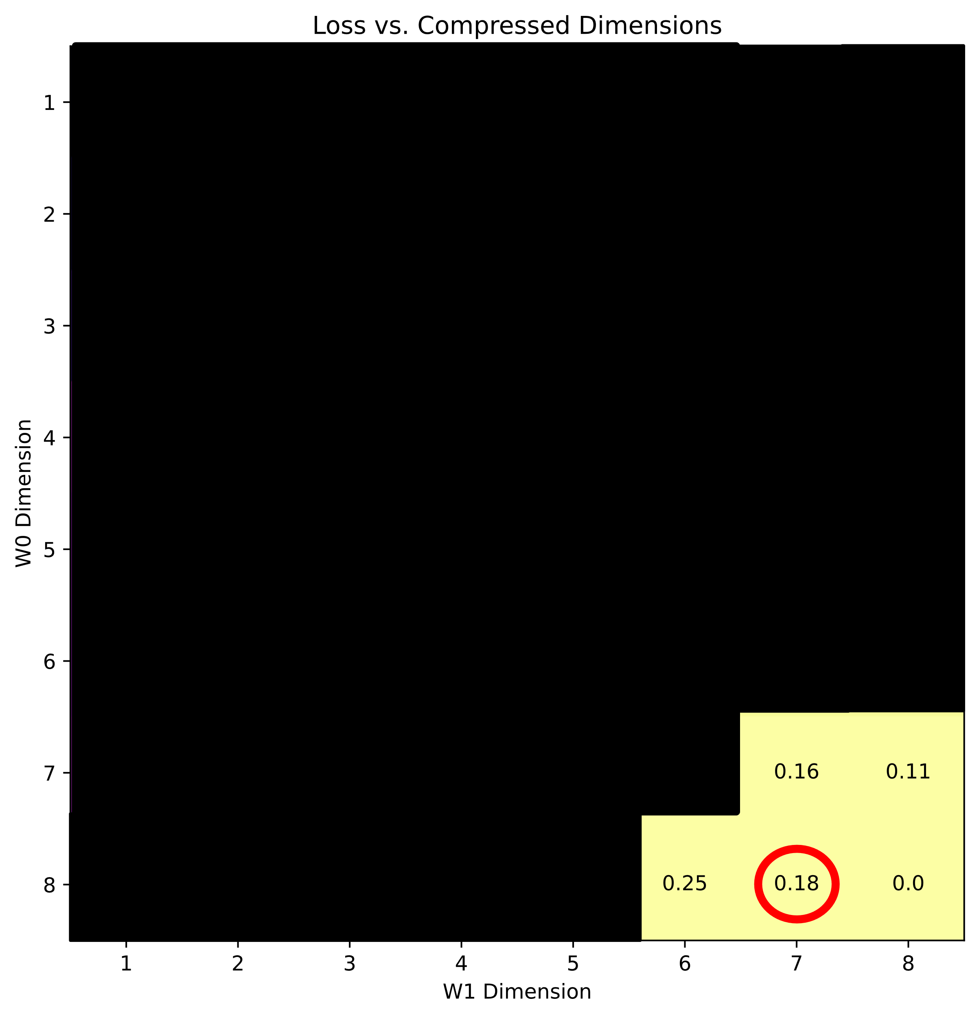
Search Algorithm up to 1 % Threshold

Slide 23
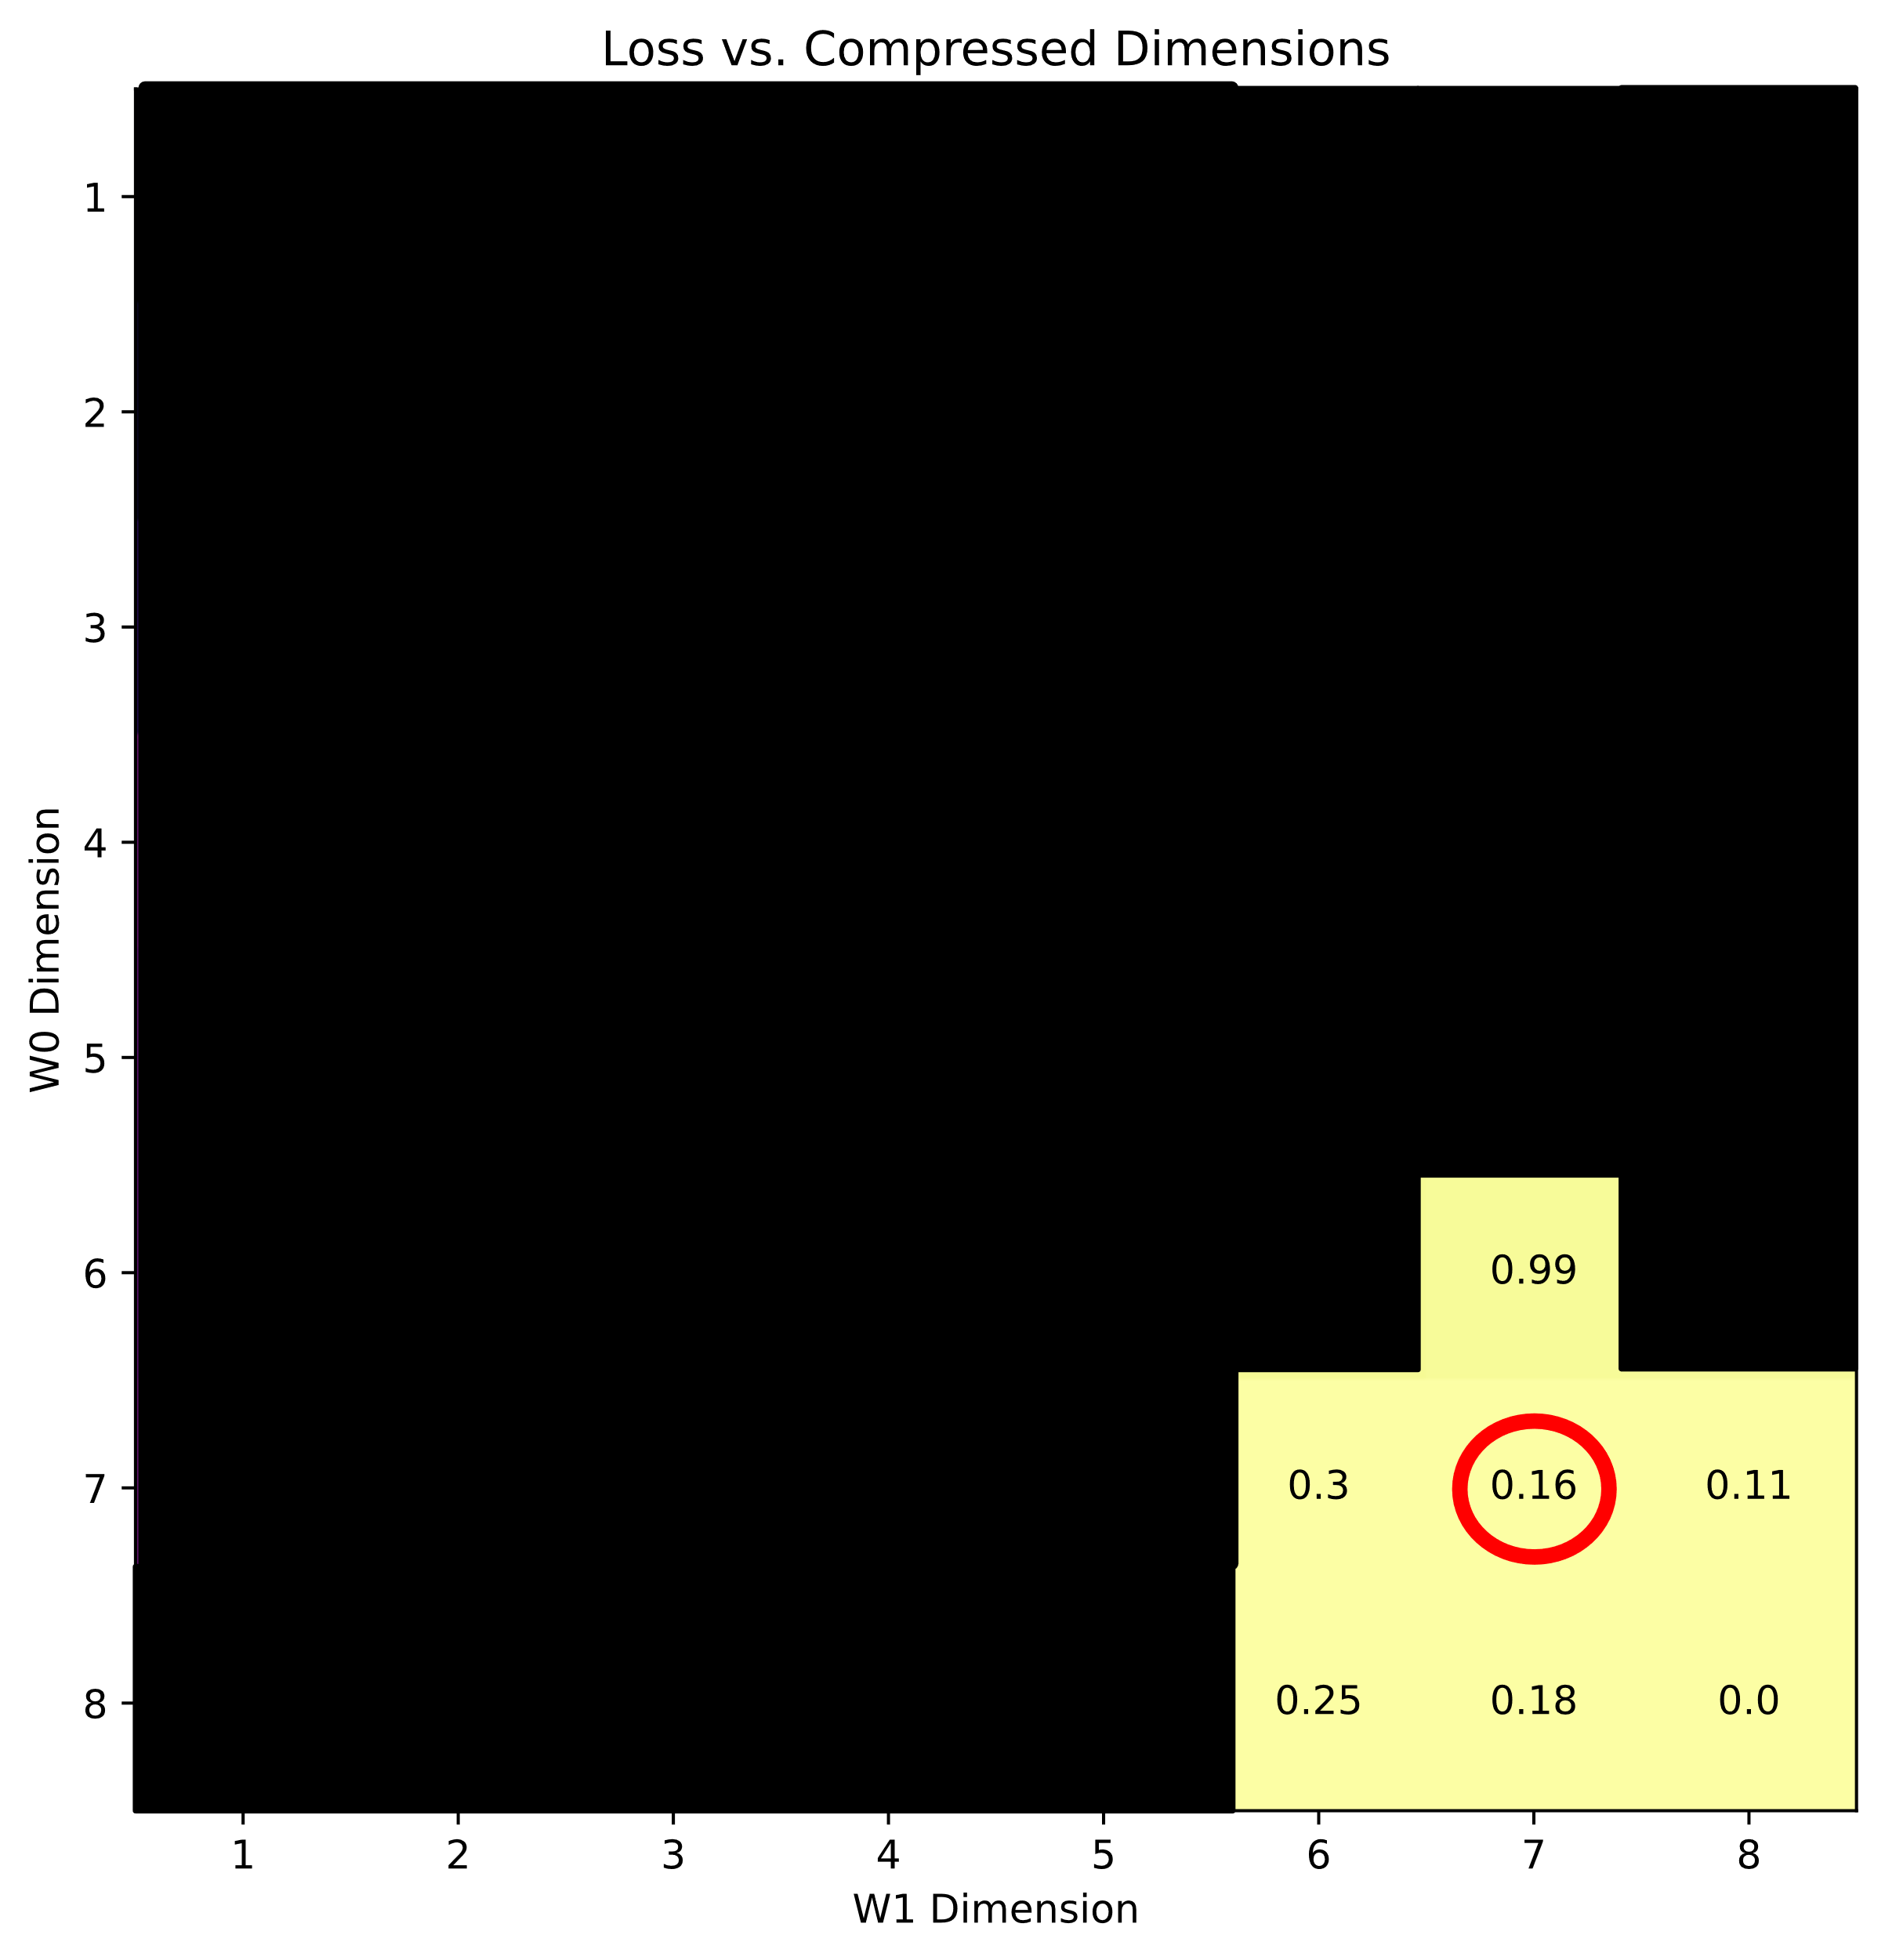
Search Algorithm up to 1 % Threshold

Slide 24
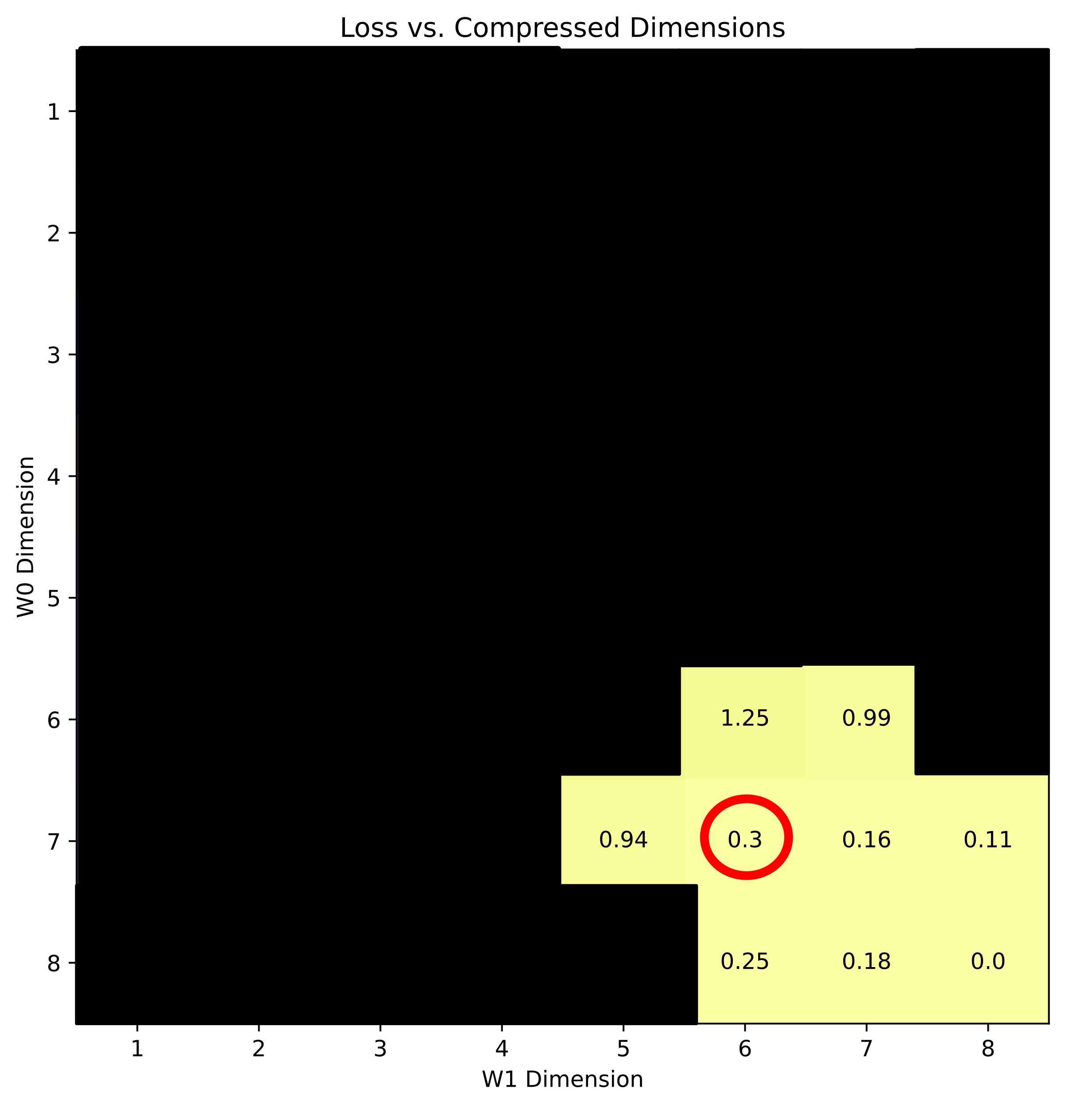
Search Algorithm up to 1 % Threshold

Slide 25
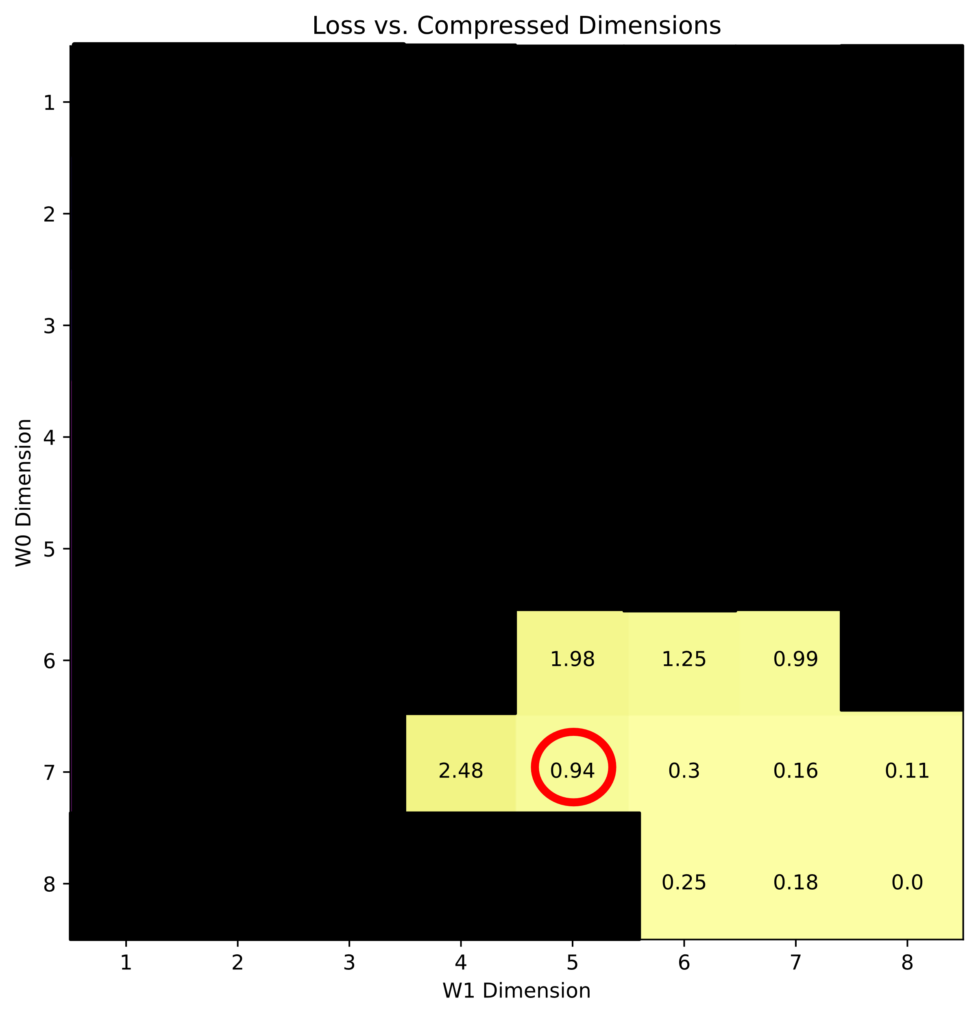
Search Algorithm up to 1 % Threshold

Slide 26
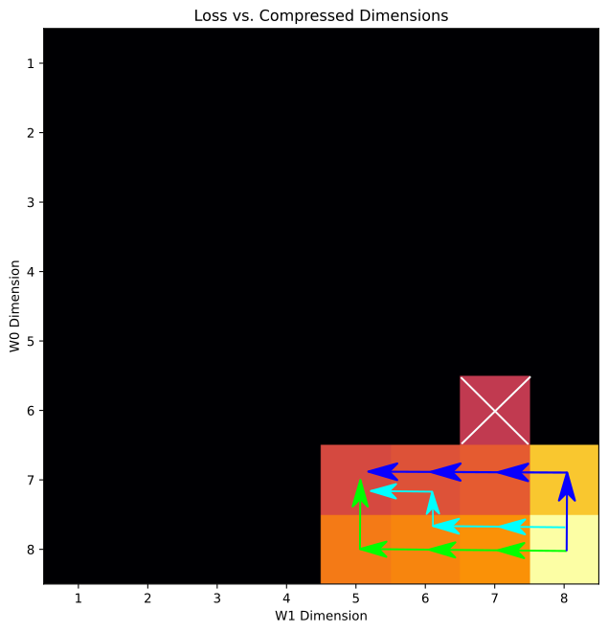
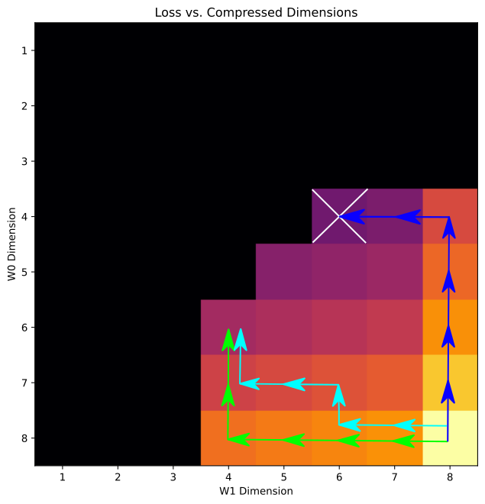
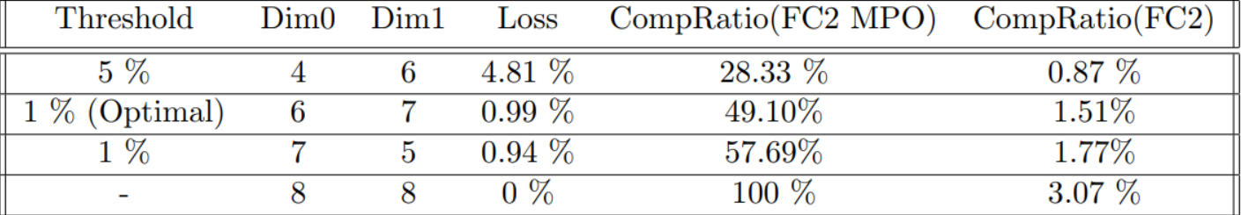
Results: Compressing FC2 MPO Net
Cyan path → Depth-First Search
Blue path → Permutation 0,1
Green path → Permutation 1,0
Nodes above loss threshold are blackened
The algorithm gives access to N!+1 local solutions for N total layers. Global solution is marked by the white X.

Slide 27
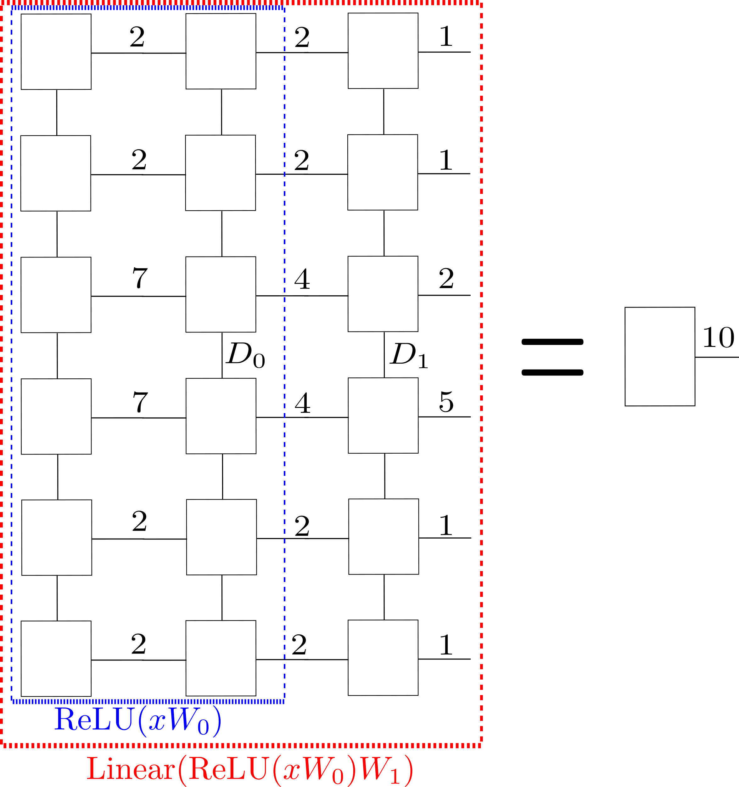
Future Improvements: MPS Input
Allows tensor contractions to be utilized during application to take full advantage of fewer parameters

Slide 28
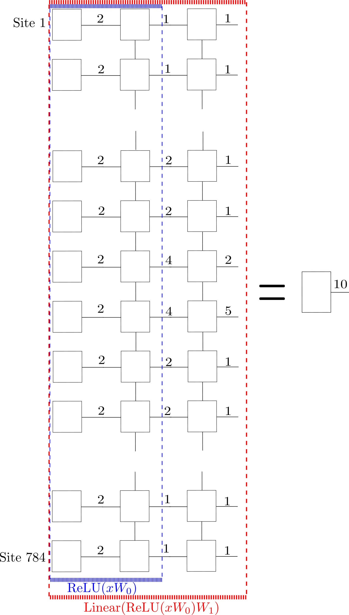
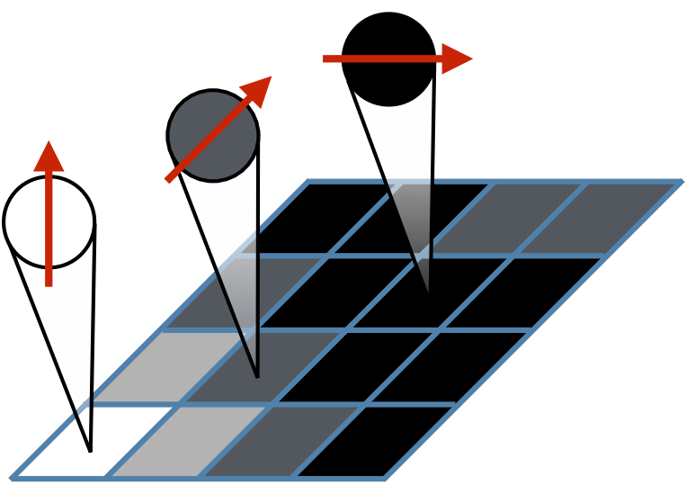
Future Improvements: Qubit Input
Utilizes tensor contraction as in MPS input, but also increases the number of sites to fully take advantage of tensor network algorithms

Slide 29
Summary
I created a Python library for the tensor network operations as well as modifications for applying them to neural networks.
For the first time, we applied a DMRG-like compression algorithm to neural networks to reduce the necessary parameters with little or even no loss of accuracy.
A neural network can be trained as an MPS/MPO (Gao 2020) upon which we can improve by applying our compression algorithm.
Overall, we have shown a proof-of-concept of applying a compression algorithm to a Fully-Connected 2 Layer network, but preliminary results show that this should generalize to convolutional layers and deep networks

Slide 30
References
J. von Delft. Lecture notes in tensor networks. Ludwig-Maximilians Universität München, July 2020
U. Schollwöck. The density-matrix renormalization group in the age of matrix product states. Annals of physics, 326(1):96-192, 2011.
Z.-F. Gao, S. Cheng, R.-Q. He, Z. Xie, H.-H. Zhao, Z.-Y. Lu, and T. Xiang. Compressing deep neural networks by matrix product operators. Physical Review Research, 2(2):023300, 2020.
E. Stoudenmire and D. J. Schwab. Supervised learning with tensor networks. In Advances in Neural Information Processing Systems, pages 4799-4807, 2016.

